Slide 1

CS 533 INTRO TO DATA SCIENCE
Michael Ekstrand

Slide 2
PREDICTION ACCURACY

Slide 3

Learning Outcomes
Compute the accuracy of a regression’s predictions
Understand the benefits of RMSE over MAE
Photo by Sheri Hooley on Unsplash

Slide 4


Prediction and Inference
Prediction tries to predict the future with the model.
Inference uses the model’s structure and parameters to learn.

Slide 5
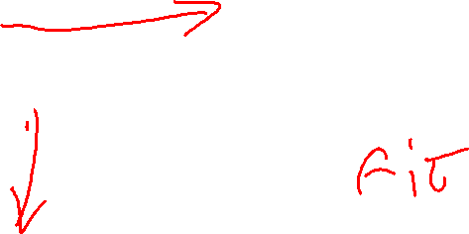
Train-Test
Data
Split
Train
Test
Model
Predict
Split before exploratory analysis of features.
Supervised learning – we have thing to predict

Slide 6

Train-Test
Create test sample:
test = predictable.sample(frac=0.2)
Filter other data for training:
train_mask = pd.Series(True, index=predictable.index)
train_mask[test.index] = False
train = predictable[train_mask]

Slide 7
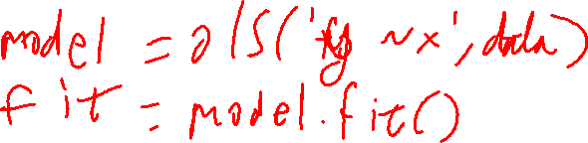
Evaluate
Fit model on train
Use fit’s predict method on test preds = pfit.predict(test)
Compare predictions to test outcomes

Slide 8

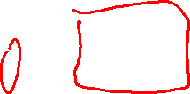
Mean Absolute Error
Take absolute values of errors
Compute the mean
$$MAE=\frac{1}{n}\sum_{i}{\left|y_{i}−{\hat{y}}_{i}\right|}$$
Why not mean error?

Slide 9


Root Mean Squared Error
Square individual errors
Compute mean, then square root
$$RMSE=\sqrt{\frac{1}{n}\sum_{i}{{\left(y_{i}−{\hat{y}}_{i}\right)}^{2}}}$$

Slide 10


Translating a Formula
$$RMSE=\sqrt{\frac{1}{n}\sum_{i}{{\left(y_{i}−{\hat{y}}_{i}\right)}^{2}}}$$
error = test['outcome'] – preds rmse = np.sqrt(np.mean(error * error))

Slide 11


Why RMSE?
Gives higher weight to large errors
${0.1}^{2}≪2^{2}$
Continuous and differentiable
Absolute value is not differentiable at 0

Slide 12
Interpreting Prediction Accuracy
MAE and RMSE are both in original outcome variable’s units
“Good enough” depends on application
What’s needed?
What’s the “noise floor” (minimum possible error)?
Can compare error of multiple models on equivalent test data

Slide 13

Wrapping Up
We measure a predictor’s accuracy by comparing predictions to test data that wasn’t seen in the training process.
Photo by Charles Deluvio on Unsplash

